Slide 1
BLITZ ⚡and WOLKE ☁️
A lightweight framework for fast, scalable image data exploration
P. Mattern, R. Krieg, H. Höft, T. Gerling, M. Becker

Slide 2
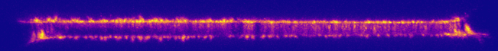


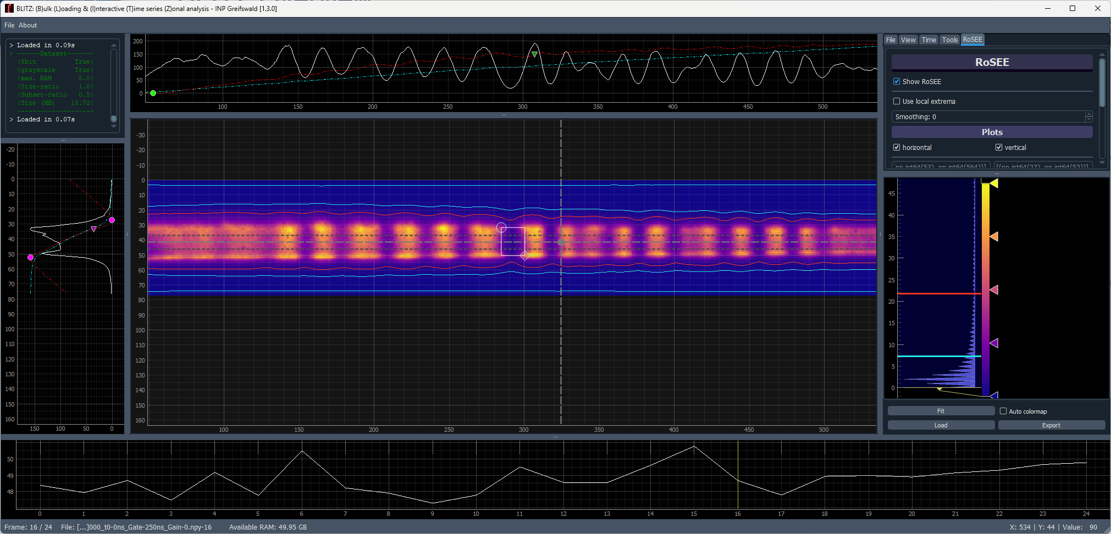
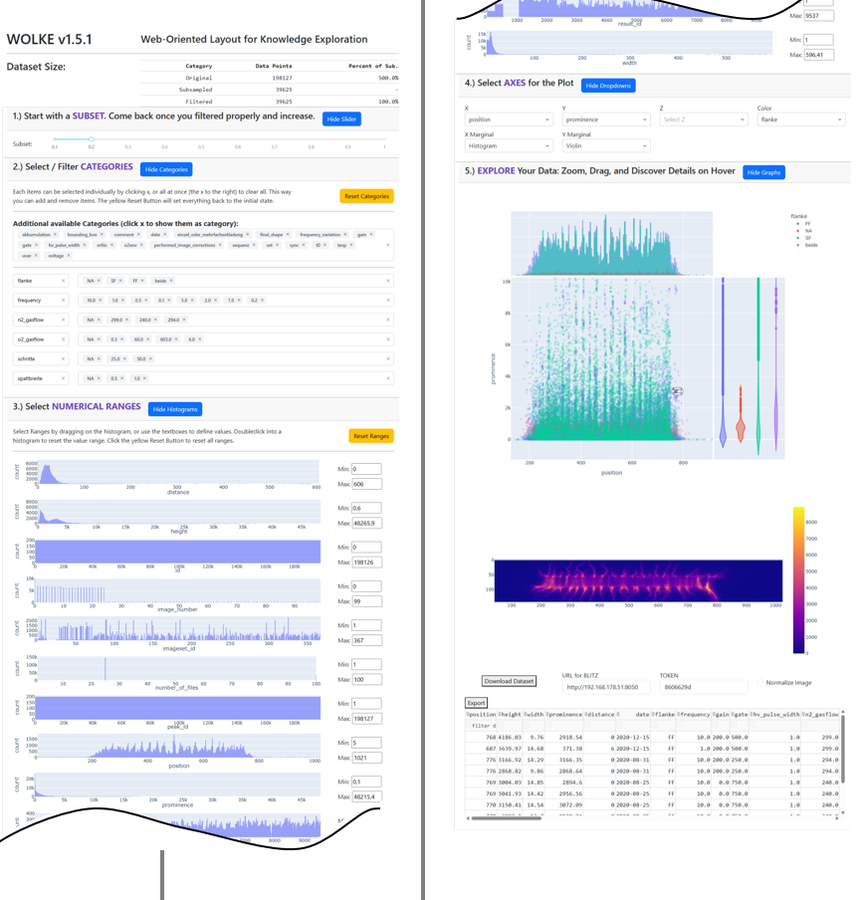
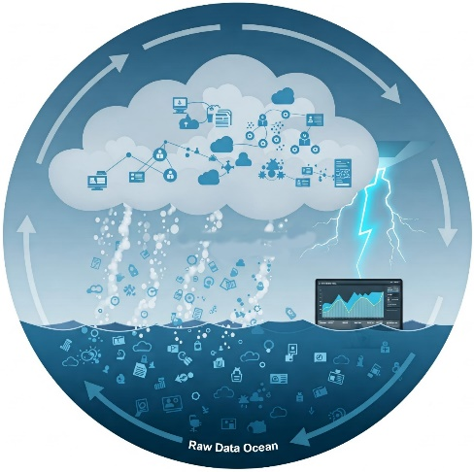
Our Journey Today
Challenges in Image-Based Experiments
Current Tools and Interfaces
BLITZ – High-speed image inspection
Integration via DAMPF
WOLKE – Metadata filtering & dashboards
Vision: The WETTER Framework

Slide 3
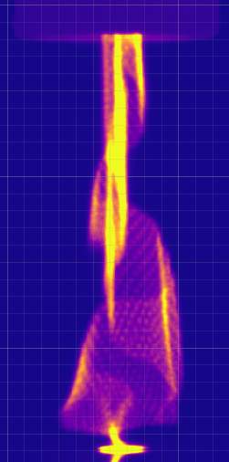




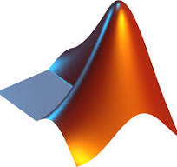

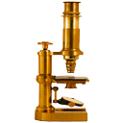

Why Handling Experimental Image Data Is Hard
🔵 Challenge ⚪ BLITZ ⚪ WOLKE ⚪ Outlook
Massive volume of data
Limited resources for handling large image datasets (computing power and storage)
Need for fast preselection and filtering methods
Visualization and metadata analysis often inefficient
Tooling is fragmented and rarely user-friendly

Slide 4
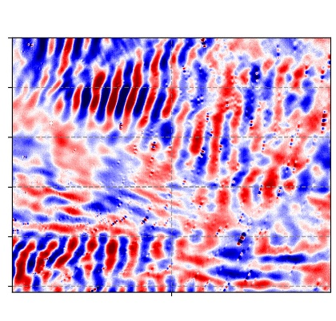
What Are We Really Dealing With?
🔵 Challenge ⚪ BLITZ ⚪ WOLKE ⚪ Outlook
Massive volume of data (Examples per Set!)
Limited resources for handling large image datasets (computing as well as storage)
Effective preselection and filtering methods
Efficient visualization and analysis of metadata
Interactivity and user-friendly interfaces
Atmospheric Airglow:
47 GB
30k files
CAPPJ (kINPen):
113 GB
36k files
Multifilament iCCD:
52 GB
32k files
Each dataset is a small universe — containing tens of thousands of frames and multiple GBs of raw data.

Slide 5
Where Does All That Data Go?
🔵 Challenge ⚪ BLITZ ⚪ WOLKE ⚪ Outlook
Massive volume of data
Limited resources for handling large image datasets (computing as well as storage)
Effective preselection and filtering methods
Efficient visualization and analysis of metadata
Interactivity and user-friendly interfaces
Scalability of Image Dataset Storage:
Storage should scale with dataset size and complexity
Metadata systems already help — even for single sets
Folder structures remain the most common solution
Storage Options by Dataset Size and Use Case
Storage Type | Typical Dataset Range | Use Case
Laptop | 10 – 1,000 images | Local experiments, quick previews
External HDD | 1,000 – 30,000 images | Archiving, manual browsing
File Server | 30,000 – 500,000 images | Shared access, project-wide datasets
Dedicated Solution | 500,000 – 10+ million | Large-scale research, searchable archives
Laptop
External HDD
File Server
Dedicated
Solution

Slide 6






How People Explore Image Data Today
🔵 Challenge ⚪ BLITZ ⚪ WOLKE ⚪ Outlook
Traditional Image Viewers:
Massive volume of data
Limited resources for handling large image datasets (computing as well as storage)
Effective preselection and filtering methods
Efficient visualization and analysis of metadata
Interactivity and user-friendly interfaces
Microsoft Fotos
ImageJ
IrfanView
Programmatic Interfaces:
Javascript
Python
Matlab
DIY Exotic Flavours:
Unmaintained scripts, forgotten web GUIs, or that one tool only Peter can run...
File Explorer:
Windows
Mac
Ubuntu
“Most of us juggle multiple tools
to get the job done —
but what if filtering, interaction, and inspection were all part of a single flow?”
Database:
Google Photos
Open Microscopy Environment

Slide 7
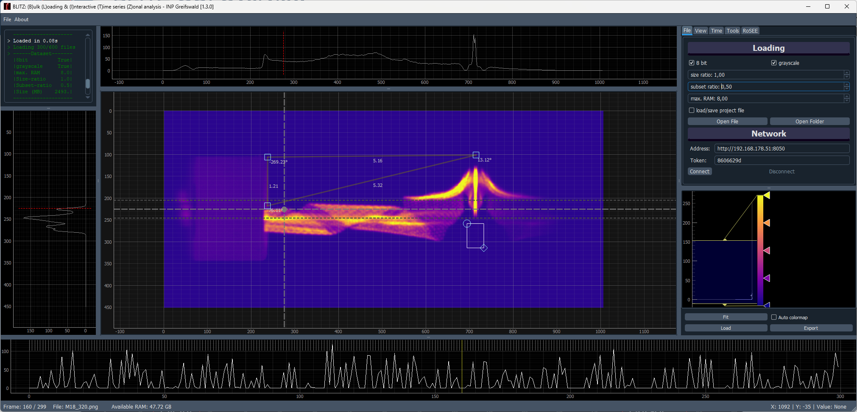
⚪ Challenge 🔵 BLITZ ⚪ WOLKE ⚪ Outlook
BLITZ
(Bulk Loading & Interactive Time-series Zonal analysis)
MEAN Horz. Intensity Profile
(with thickness)
Options
Log
ROI Measurements
Single Line
Vert. Intensity
Profile
LUT
Zonal Intensity
over time
Timeline
File and RAM info
Cursor info

Slide 8
BLITZ
⚪ Challenge 🔵 BLITZ ⚪ WOLKE ⚪ Outlook
(Bulk Loading & Interactive Time-series Zonal analysis)
Definition and Purpose:
Matrix-based interactive image viewer
Designed for efficient large-scale image datasets
Key Features:
Extremely fast loading (e.g. 21,000 images, 25 GB in 35 sec)
Real-time interactive exploration and analysis
Robust tools for measuring, profiling, and zonal analysis
Drag & Drop support for quick dataset loading
When traditional tools choke on 10,000+ images, BLITZ opens them in seconds - ready to analyze.

Slide 9
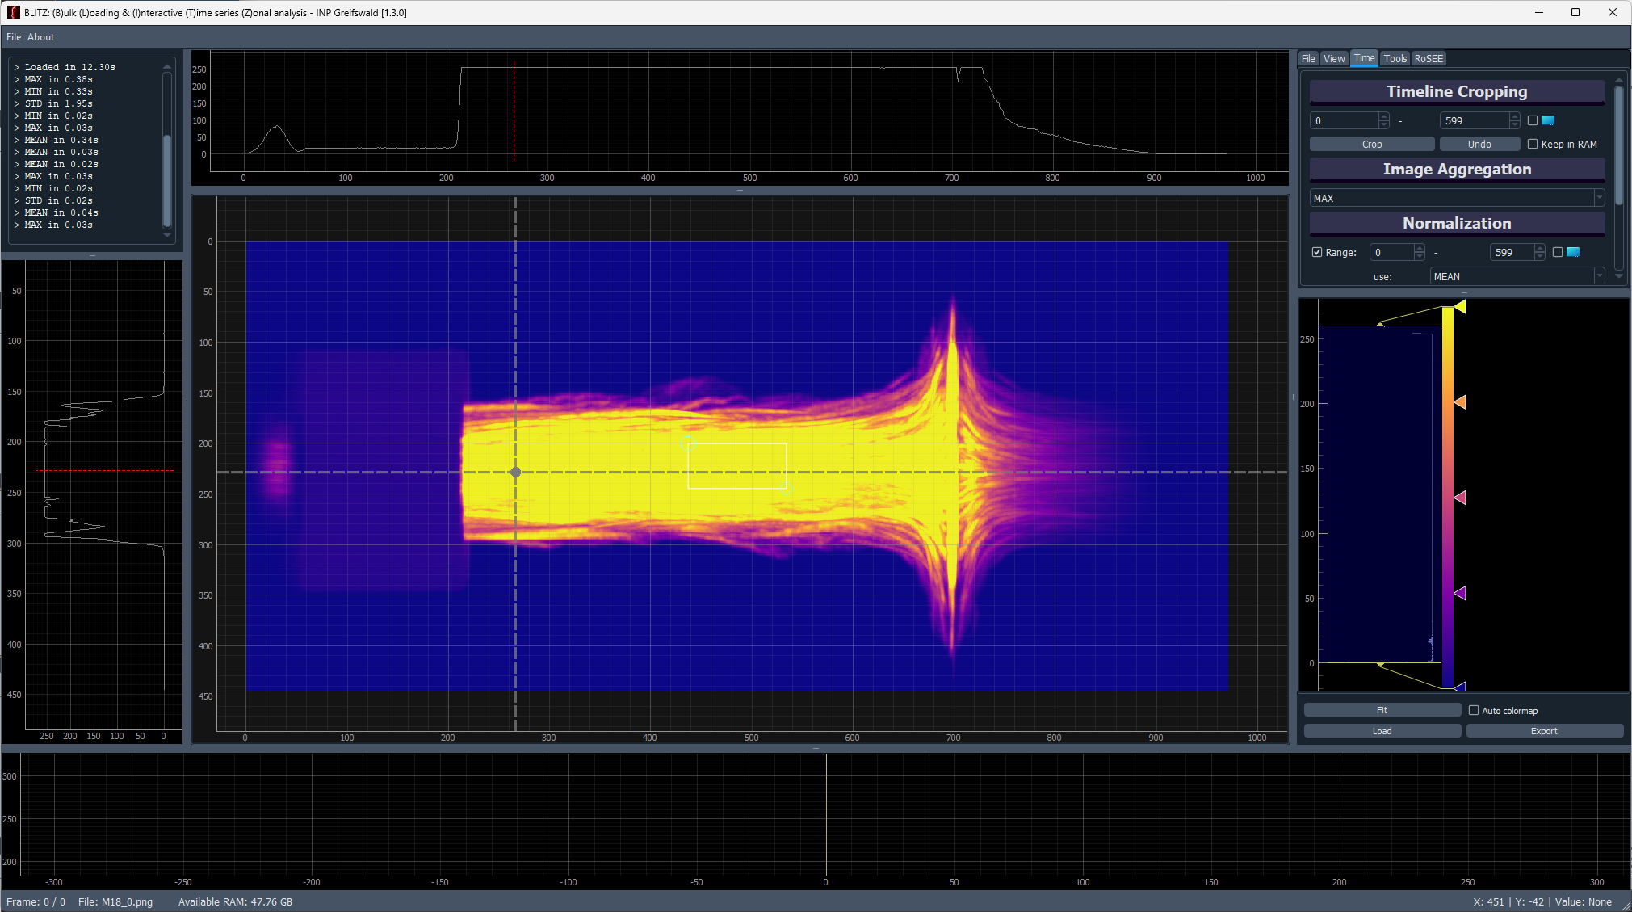
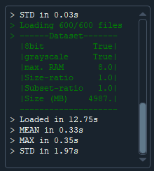
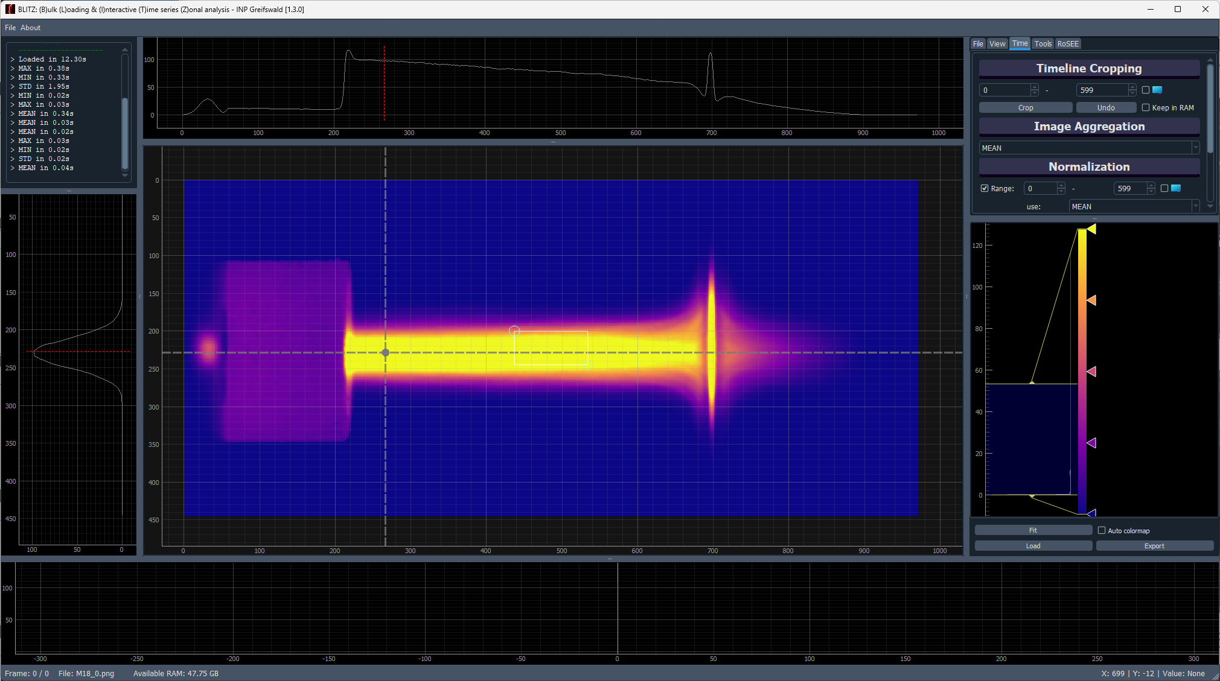
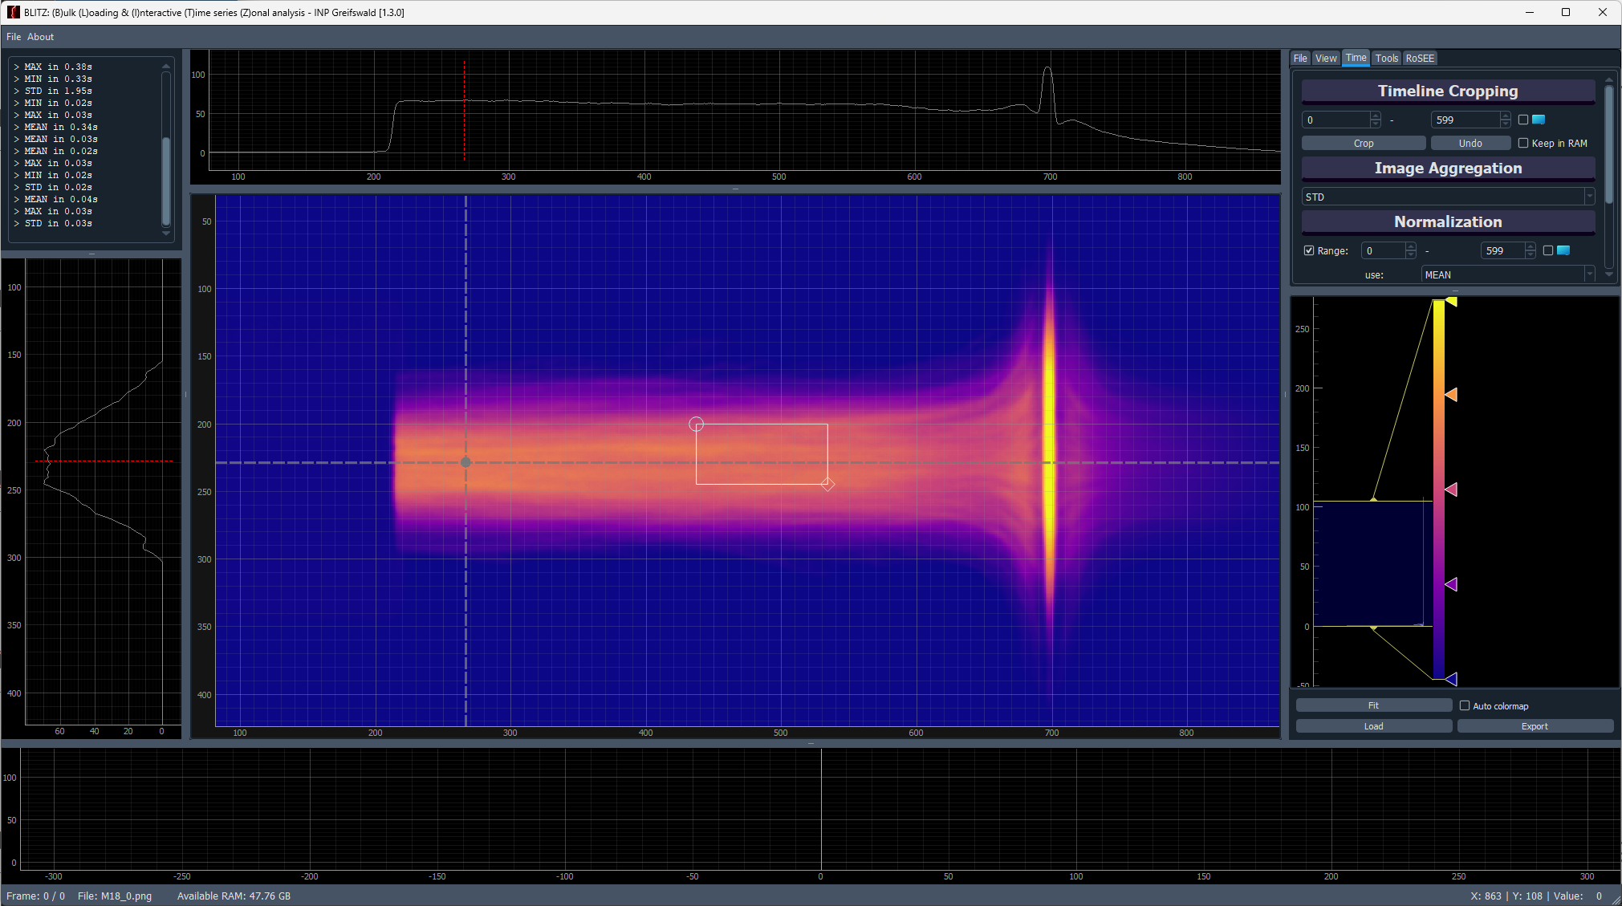
BLITZ - Performance
⚪ Challenge 🔵 BLITZ ⚪ WOLKE ⚪ Outlook
Matrix based approach:
600 images (5 GB) loaded in 12 sec
MAX / MEAN in < 0.35 sec
STD in < 2 sec
_(Tested on a gaming laptop)_
Maximum
Intensity Values per Pixel over Time
Built for users who just don’t want to wait …
Mean
Standard Deviation

Slide 10


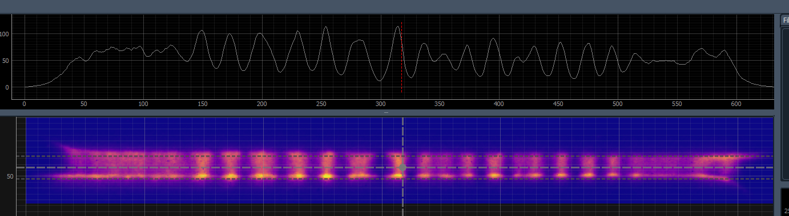
DAMPF (Data Aggregation & Modular Processing Framework)
⚪ Challenge 🔵 BLITZ 🔵 WOLKE ⚪ Outlook
Width
Image Folder Structure
Angle
Length
Non- Domain Specific Metrics
kINPen
i.e. via OpenCV:
Min, Max, Mean Intensity
Laplacian („Noise“)
Self-similarity (auto-correlation)
Date / Time
Domain Specific Metrics
All into a SQL DB
Position:
Multifilament
Experimental Conditions:
Voltage
Current
Gas Mixture
…
Creating Metadata from Raw Image Folders
“Think of DAMPF as your metadata generator — turning folders into searchable databases.”

Slide 11
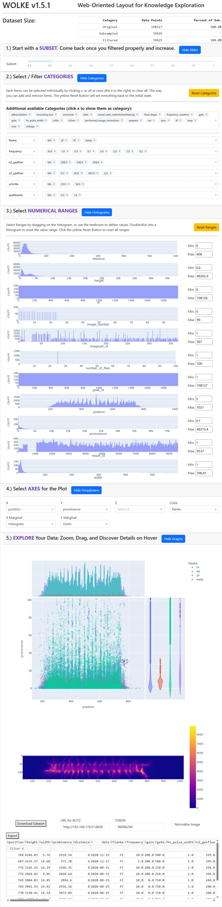
WOLKE
⚪ Challenge ⚪ BLITZ 🔵 WOLKE ⚪ Outlook
(Web-Oriented Layout for Knowledge Exploration)
An interactive web dashboard built with Dash-Plotly for efficient metadata filtering and visualization.
Functionality:
Explore metadata by type: numeric or categorical
Create interactive x/y/(z) scatter plots with color-coded metadata
WOLKE helps researchers reduce complexity and focus on relevant subsets – no coding required.

Slide 12
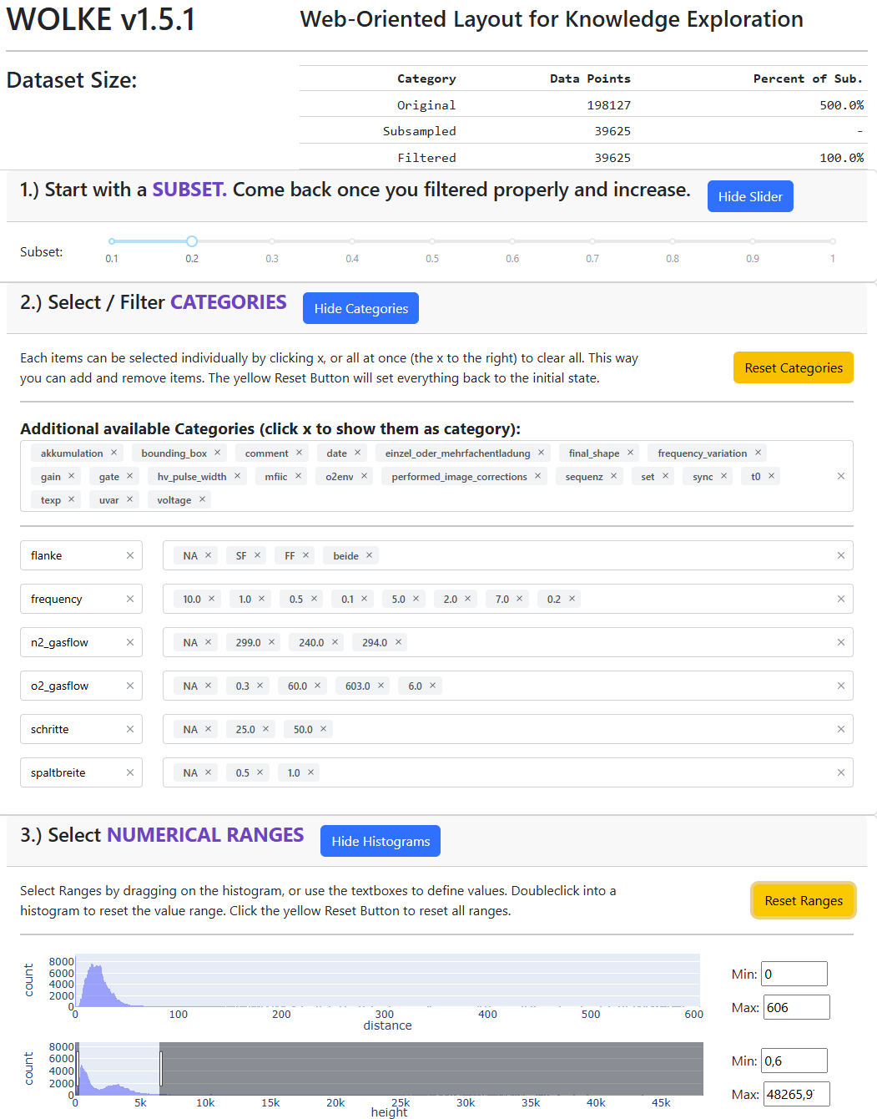
Subset and Filtering
⚪ Challenge ⚪ BLITZ 🔵 WOLKE ⚪ Outlook
1.) Start with a Subset:
Improves performance on large datasets
2.) Filter Categories:
Categories = all non-numeric data
Numeric data with low variance (e.g. frequency, n=8) can also be treated as categories
3.) Filter Numerical Ranges:
View histogram of value distribution
Filter using range sliders or input fields

Slide 13
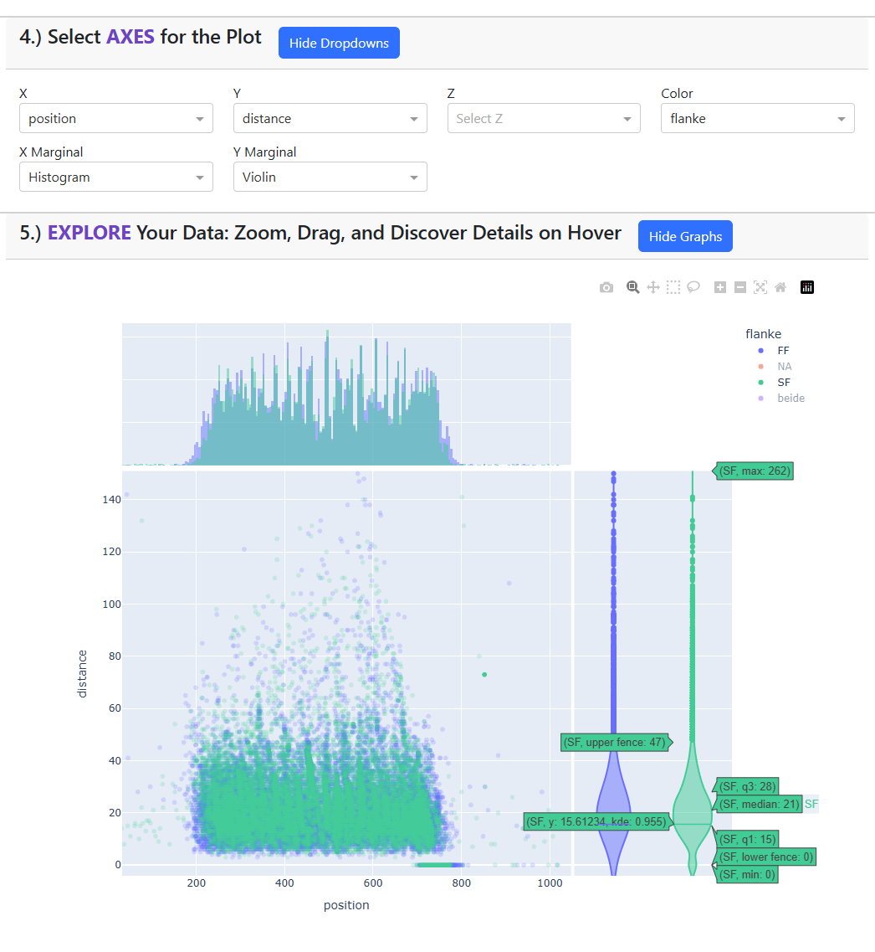
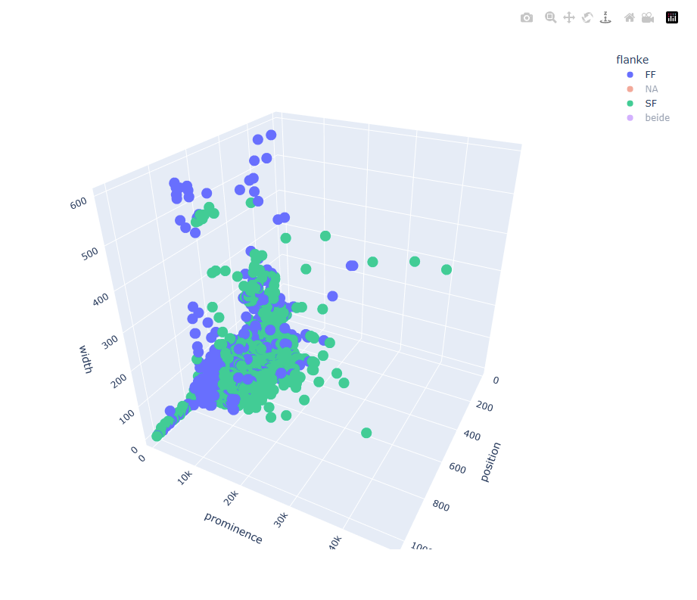
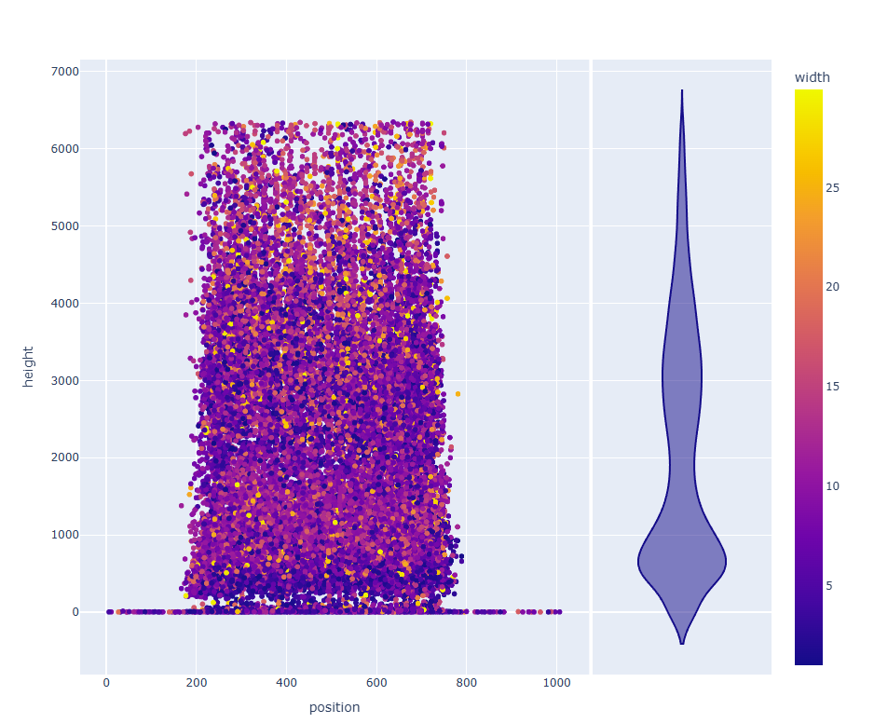
⚪ Challenge ⚪ BLITZ 🔵 WOLKE ⚪ Outlook
Visual Data Exploration
4.) Select Plot Axis:
2D or 3D scatter plots
Optional: Add side plots for statistics (e.g. histogram, violin)
5.) Explore Your Data Visually:
Zoom, drag, and hover with your mouse
Show/hide categories to focus the view
Select single or multiple data points interactively
Continous Colorscale
3D Scatter

Slide 14
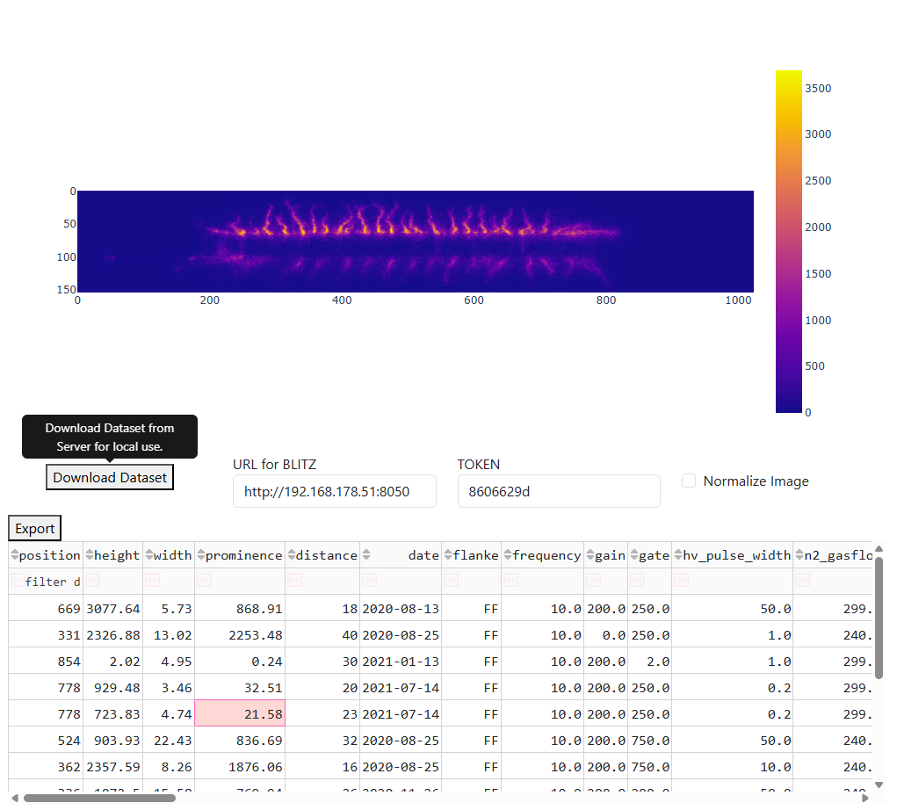
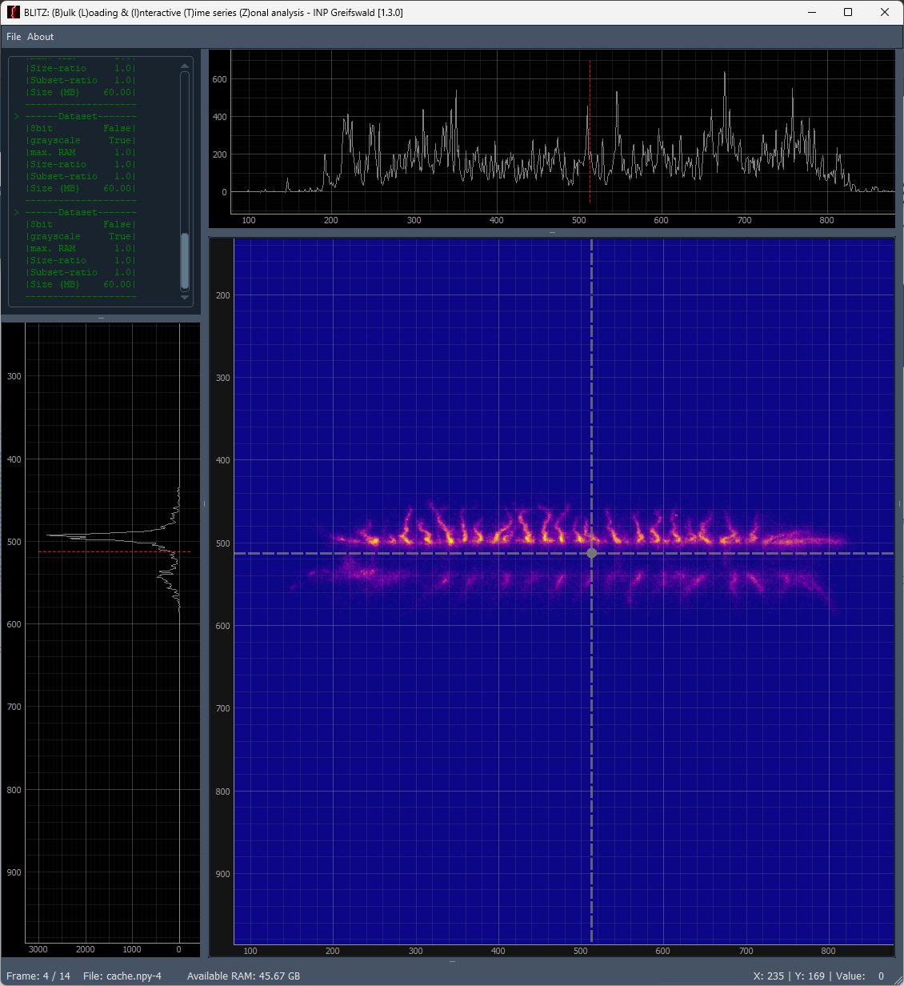
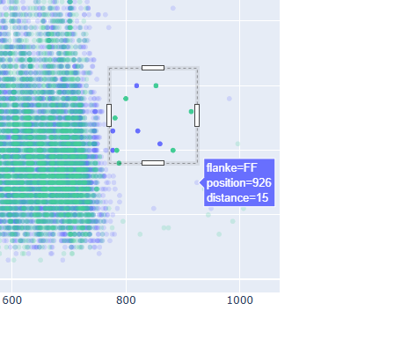
⚪ Challenge ⚪ BLITZ 🔵 WOLKE ⚪ Outlook
From filtered metadata to deep image analysis — seamlessly.
Select
Inspect
Synchronize with the BLITZ!
WOLKE provides filtered data via HTTP as *.npy arrays,
which can be instantly opened in BLITZ —
or integrated into your own analysis framework.

Slide 15
From Folder to Insight: Your Workflow with DAMPF, WOLKE & BLITZ
⚪ Challenge ⚪ BLITZ ⚪ WOLKE 🔵 Outlook
Augment metadata with DAMPF
(and store in SQL)
Filter and preselect using WOLKE
Keep your image data in folders …just like you're used to!
Preview directly with BLITZ
(Drag & Drop sneak peek)
Synchronize filtered sets with BLITZ for detailed inspection

Slide 16






Outlook: WETTER Framework
WOLKE
BLITZ
DAMPF
Your Contribution?
HAGEL
Get rid of heavy outliers
SCHNEE
NEBEL
Solidify trustworthy data
Reveal Patterns in the fog of data
REGEN
Gather new Data by learning from the old
Notes:
PROMPT for Imagen 3: Create a visually appealing infographic depicting a circular data processing cycle themed around weather phenomena. At the bottom of the circle, represent a vast ocean filled with numerous symbolic data points, icons, images, and documents floating in deep blue water.
Above the ocean, illustrate data evaporating upward as translucent streams or mist. These streams should visually represent data transformation—raw images and documents gradually dissolving into digital symbols as they ascend.
In the upper-middle area, form a large cloud. Within this cloud, visually emphasize structured metadata, connections, and organized data points, signifying prepared, web-oriented knowledge.
From this cloud, a vibrant lightning bolt labeled strikes downward and outward. The lightning should illuminate a digital dashboard or analytical interface, clearly showing data being interactively analyzed and visualized.
Ensure the visual style is modern, clean, and professional, with harmonious colors reflecting each stage (ocean in deep blue tones, steam in gentle whites and greys, cloud in soft blues and whites, lightning in striking yellow or electric blue). The overall appearance should clearly convey a seamless, cyclic flow of data transformation and utilization.
Do not write any Text! REGEN :
Regain Experience by Generation of Experimental Needs

